Slide 1


Graphics
Images within 2D games
Part 8 – Practical Rendering

Slide 2

Loading and Storing Images

Slide 3

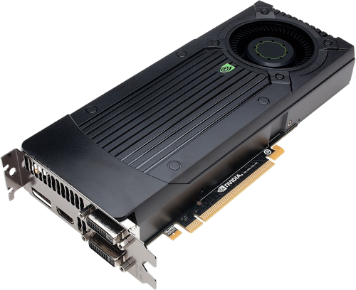

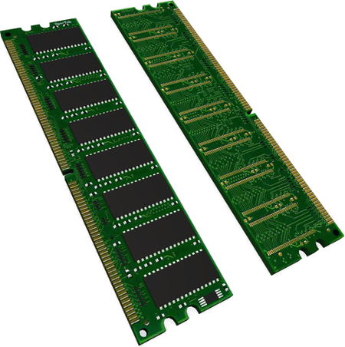
Loaded images will be stored in the device’s RAM. On some devices a dedicated amount of VRAM may be available.
Draw request
Load request
Image data
Image data

Slide 4
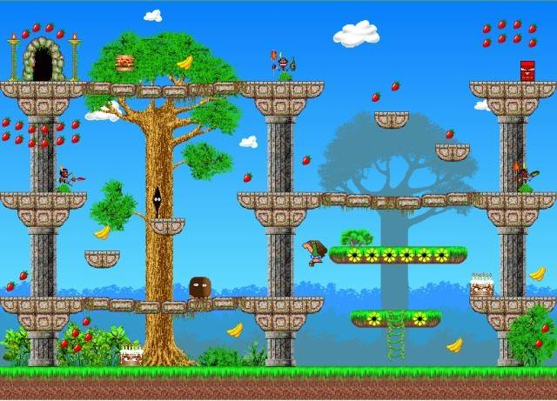
Memory space tends to be a limiting factor for many games.
This can be overcome through an asset manager that:
permits asset sharing across game objects by issuing references to assets
loads/discards assets (per level, dynamically, etc.)

Slide 5
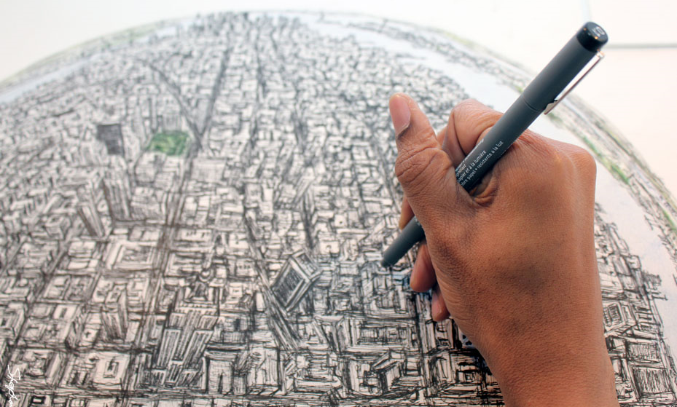
Drawing the game world

Slide 6
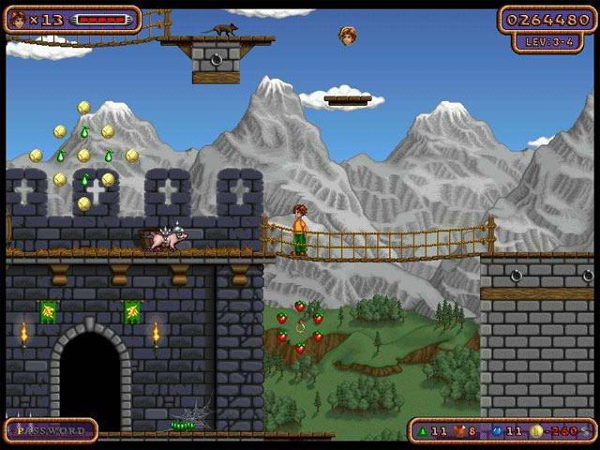

: Draw Order
In order to provide consistent depth perspective it is important that the game objects are drawn with a controlled and consistent ordering.
Player drawn in front of background and castle wall, but behind rope bridge.
Castle wall drawn in front of background scenery
Hud drawn on top of everything
The draw can be separated into a number of ‘layers’ that are drawn on top of each other.

Slide 7






: Different Types of Layer
The layers that are drawn to visualise the world may be of a different size or type, but often linked, e.g.:
Game layer: Much wider than screen. Contains lots of game objects.
Background layer: Slightly wider than the screen. Contains an image ribbon.
When the game layer is moved by x units the background layer is also moved by x unit (or less given multiple parallax layers).

Slide 8
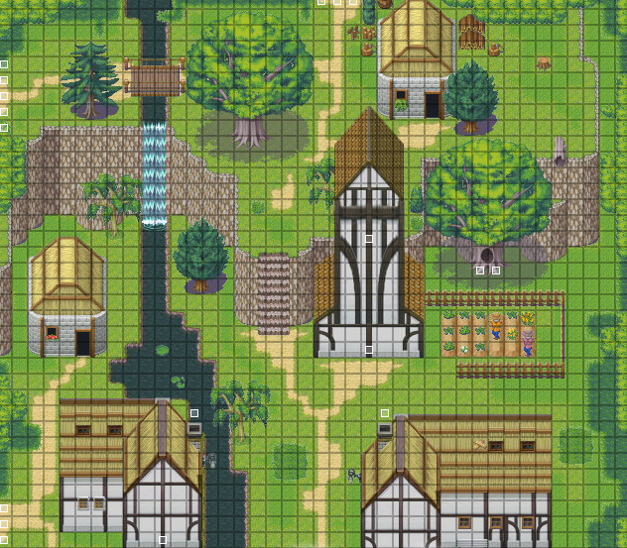
: Culling
A game may use a viewport to control which portion of the world is played on the screen.
There is no point in spending effort ‘drawing’ objects that fall outside of the viewport.
A number of different ‘scene graphs’ can be used to efficiently structure and query objects.
World
Screen

Slide 9



: Maximising Performance
In order to draw an image the GPU must configure itself, e.g. load/setup texture, etc.
Performance is maximised when the GPU draws all requests for a given image in a single batch (single setup cost)
Poor performance arises when the GPU needs to setup an image each draw request.
Hint: Store multiple images in a single bitmap and select specific draw regions.

Slide 10

Have a clear vision of how you want your game to look. Decompose your vision into a number of layers. Determine what is displayed in each layer. Finally draw.

Slide 11

Summary of steps

Slide 12



: Image Loading and Management
In your game design you should consider the following separate-but-dependent processes.
Q1: What graphics need to be loaded? In what order? All at once?
Q2: How are assets managed?
Load graphics
Asset Manager
Request / receive graphics
Q3: Which graphics are used by each game object? How/when do game objects obtain graphics from the manager.
Game objects

Slide 13


: Image Drawing
Layers
Game objects
Drawing a layer
Visible objects
Draw ordering
Q1: Which layers should be drawn? In what order?
Q2: Which layer objects are visible and should be drawn?
Drawing
Q3: In what order should visible objects be drawn?
Q4: How will each object be drawn?

Slide 14

Key takeaways:
Have a clear vision of how you want your game to look.
Model the game as one or more layers that contain a number of game objects.
In each visible layer select those objects which are visible, determine the order in which they should be drawn and then draw each object individually.

